Slide 1
IMPORTANT IDENTITIES AND FORMULAS

Slide 2
CLASS 5TH

Slide 3
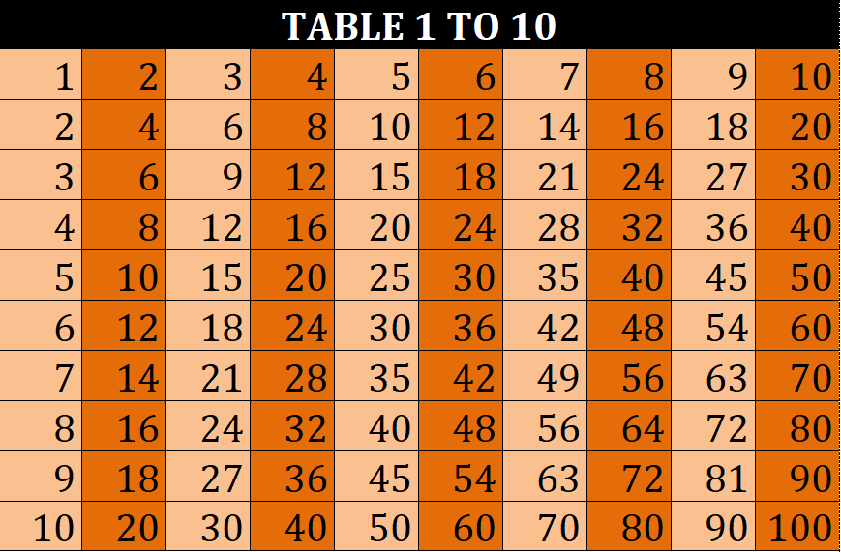

Slide 4
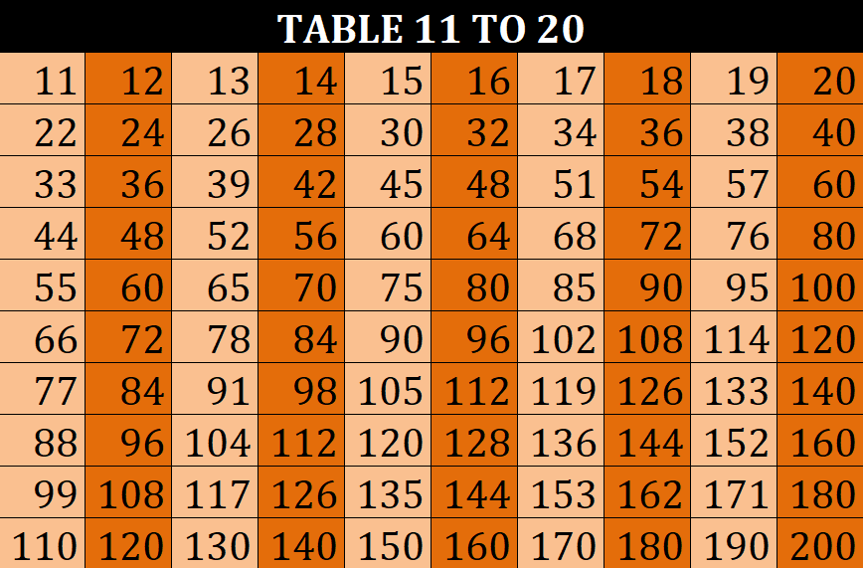

Slide 5
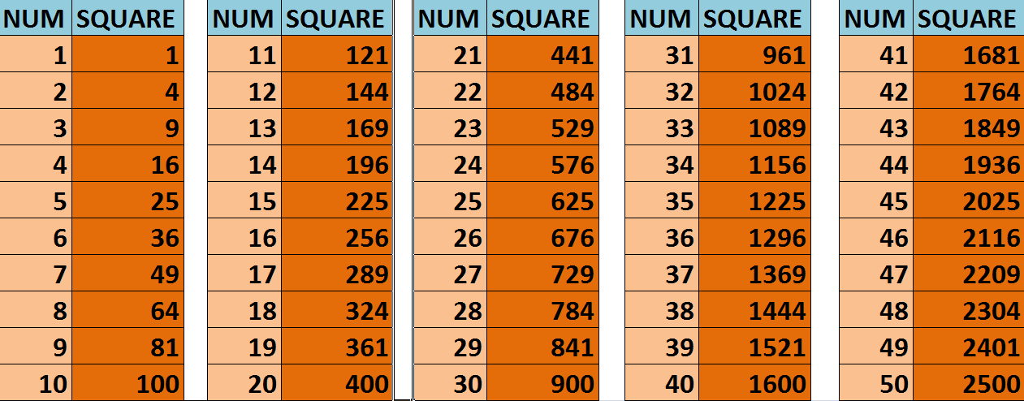
SQUARES 1 TO 50

Slide 6
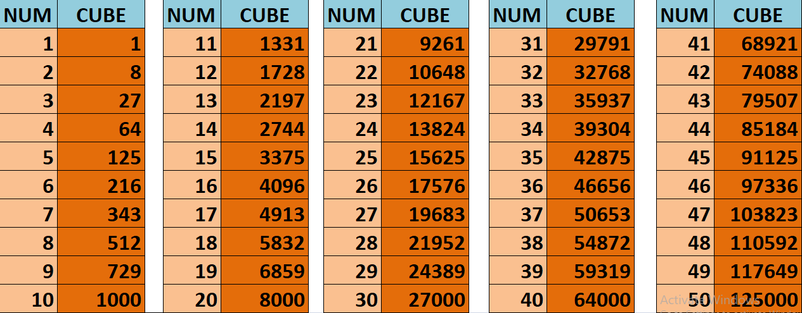
CUBES 1 TO 50

Slide 7
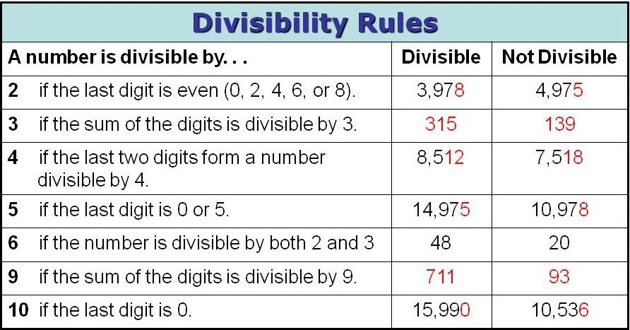

Slide 8
Length
Measurement
Kilometer
Millimeter
Decameter
Meter
Decimeter
Centimeter
Hectometer
÷ 10
x 10
÷ 10
x 10
÷ 10
x 10
÷ 10
x 10
÷ 10
x 10
÷ 10
x 10

Slide 9
Weight
Measurement
Kilogram
Milligram
Decagram
Gram
Decigram
Centigram
Hectogram
÷ 10
x 10
÷ 10
x 10
÷ 10
x 10
÷ 10
x 10
÷ 10
x 10
÷ 10
x 10

Slide 10
Liquid
Measurement
Kilolitre
Millilitre
Decalitre
Litre
Decilitre
Centilitre
Hectolitre
÷ 10
x 10
÷ 10
x 10
÷ 10
x 10
÷ 10
x 10
÷ 10
x 10
÷ 10
x 10

Slide 11
Money
Measurement
Rupees
Paise
x 100
÷ 100

Slide 12
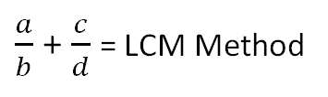
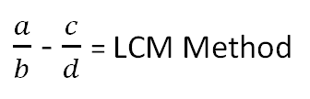
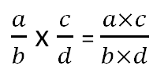
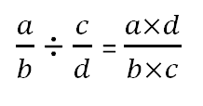
ARITHMATIC CALCULATION OF FRACTIONS

Slide 13
CLASS 6TH

Slide 14
Quantity weights:
a) 1 kilometer (km) = 1000 Meters (m)
b) 1 Meter (m) = 100 Centimeter (cm)
c) 1 Centimeter (cm) = 10 Millimeter (mm)
d) 1 Kilogram (kg) = 1000 Grams (gm)
e) 1 Liter (l) = 1000 Milliliters (ml)

Slide 15
Roman Numerals:
I – 1
II – 2
V – 5
X – 10
L – 50
C – 100
D – 500
M – 1000

Slide 16
PROPERTY | IMPLEMENTATION
Closure Property of Addition Closure Property of Multiplication | Integer + Integer = Integer Integer x Integer = Integer
Commutative Property under Addition Commutative Property under Multiplication | a + b = b + a a x b = b x a
Associativity of Addition Associativity of Multiplication | (a + b) + c = a + (b + c) a × (b × c) = (a × b) × c
Distributive Property under Addition Distributive Property under Subtraction | a × b + a × c = a × (b + c) a × b – a × c = a × (b – c)
Additive Identity | a + 0 = a = 0 + a
Multiplicative Identity | a × 0 = 0 = 0 × a

Slide 17
Mensuration
Perimeter of a rectangle = 2 × (length + breadth)
Perimeter of a square = 4 × length of its side
Perimeter of an equilateral triangle = 3 × length of a side
Area of a rectangle = length × breadth
Area of a square = side × side = (side)²

Slide 18
Algebra Formulas
x × y = xy;
such as 5 × a = 5a = a × 5.
a × a × a × … 9 times = a¹²

Slide 19
CLASS 7TH

Slide 20
Practical Geometry
Area of a Square = Side²
Perimeter of a Square = 4 × Side
Area of Rectangle = Length × Breadth
Perimeter of a Rectangle = 2 × (Length + Breadth)
Area of a Parallelogram = Base × Height
Area of Triangle = 1/ 2 × Base × Height
Circumference of a circle = π d, where 'd' is the diameter of a circle and π = 22/7 or 3.14
Area of a circle = πr²

Slide 21
Exponents and Power Formulas
Law of Product: a^{m} × a^{n} = a^{m+n}
Law of Quotient: a^{m}/a^{n} = a^{m-n}
Law of Zero Exponent: a⁰ = 1
Law of Negative Exponent: a^{-m} = 1/a^{m}
Law of Power of a Power: (a^{m})^{n} = a^{mn}
Law of Power of a Product: (ab)^{m} = a^{m}b^{m}
Law of Power of a Quotient: (a/b)^{m} = a^{m}/b^{m}

Slide 22
Comparing Quantities Formulas
Increase in Percentage
= (Change / Original Amount) × 100
Profit percent
= (Profit / Cost price) × 100
Simple Interest
= (Principal × Rate × Time) / 100
Amount = Principal + Interest

Slide 23
Algebra Formulas
(a-b)² = a² - 2ab + b²
(a-b-c)² = a² + b² + c² - 2ab + 2bc - 2ac

Slide 24
Important Formulas
a^{x} / a^{y} = a^{x-y}
a^{x} /b^{x} = (a/b)^{x}
(a^{x})^{y} = a^{xy}
(a-b-c)² = a² + b² + c² - 2ab + 2bc - 2ac
Increase in Percentage = (Change / Original Amount ) × 100
Profit percent = (Profit / Cost price) × 100
Simple Interest = (Principal × Rate × Time) / 100
Amount = Principal + Interest
Pythagoras Theorem : (Hypotenuse)² = (Adjacent Side)² + (Opposite Side)²
Area of a Circle = πr ², where 'r' is the radius of a circle and π = 22/7 or 3.14

Slide 25
CLASS 8TH

Slide 26
Rational Numbers
Additive Identity states (a ⁄ b + 0) = (a ⁄ b)
Multiplicative Identity states (a ⁄ b) × 1 = (a/b)
Multiplicative Inverse states (a ⁄ b) × (b/a) = 1
Additive Inverse is defined as the value, which on adding with the original number results zero value.
a+(-a)=a-a=0
Original Number + x=0
Additive Inverse of 10 is -10

Slide 27
The Multiplicative inverse of a number, say, N, is represented by 1/N or N⁻¹
It is also called reciprocal.
Fact : When a number by its own multiplicative inverse, the resultant value is equal to zero.

Slide 28
Geometry
Curved Surface Area of a Cone = 1 /2 × l × 2πr = πrl, where ‘r’ is its base radius and ‘l’ its slant height. ‘l’ = √(r² + h²)
Volume of a Cuboid
= Base Area × Height
= Length × Breadth × Height
Volume of a Cone = (1 / 3 )πr²h
Volume of a Sphere = (4/3) π r³
Volume of a Hemisphere = (2/3) πr³

Slide 29
Exponents Formulas
Law of Product: a^{m} × a^{n} = a^{m + n}
Law of Quotient: a^{m}/a^{n} = a^{m - n}
Law of Zero Exponent: a⁰ = 1
Law of Negative Exponent: a^{-m} = 1/a^{m}
Law of Power of a Power: (a^{m})^{n} = a^{mn}
Law of Power of a Product: (ab)^{m} = a^{m}b^{m}
Law of Power of a Quotient: (a/b)^{m} = a^{m}/b^{m}

Slide 30
Comparing Quantities Formulas
Discount = Marked Price - Sale Price
Simple Interest = ( Principal × Rate × Time )/100
Compound Interest Formula = Amount - Principal
If the interest is to be calculated annually, then
Amount = Principal ( 1 + Rate/100)^{n}
‘n’ is the time period.

Slide 31
Algebra
(a + b)² = a² + 2ab + b²
(a + b) (a - b) = a² - b²
(a - b)² = a² - 2ab + b²

Slide 32
Important Formulas
Additive inverse of rational number: a/b = -b/a
Multiplicative Inverse of a/b = c/d , if a/b × c/d = 1
Distributivity a(b - c) = ab - ac
Probability of the occurrence of an event = Number of outcomes that comprise an event/ Total number of outcomes
Compound Interest formula = Amount - Principal, Amount in case the interest is to be calculated annually = Principal ( 1 + Rate/100)^{n}, where ‘n’ is the time period.
(a - b)² = a² - 2ab + b²
(a + b) (a - b) = a² - b²
Euler’s Formula: For any polyhedron, Number of faces + Number of vertices - Number of edges = 2
Volume of a Cone = (1 / 3 )πr²h
Volume of a Sphere = (4/3) π r³

Slide 33
CLASS 9TH

Slide 34
Number System
√ab = √a √b
√(a/b) = √a / √b
(√a + √b) (√a - √b) = a - b
(√a + √b)² = a + 2√ab + b
(a + √b) (a - √b) = a² - b
(a + b) (a - b) = a² - b²

Slide 35
Algebra Formulas
(x+ y)² = x² + 2xy + y²
(x – y) ² = x ² – 2xy + y ²
x ² – y ² = (x + y) (x – y)
(x + a) (x + b) = x ² + (a + b)x + ab

Slide 36
(x + y + z) ² = x ² + y ² + z ² + 2xy + 2yz + 2zx
(x - y)³ = x³ - y³ - 3xy(x - y)
(x – y) ³ = x ³ – y ³ – 3xy(x – y)
= x ³ – 3x ²y + 3xy² – y ³
x ³ + y ³ + z ³ – 3xyz
= (x + y + z)(x ² + y ² + z ² – xy– yz – zx)

Slide 37
SURFACE AREAS AND VOLUMES
Curved Surface Area of a Cone = 1/2 × l × 2πr = πrl
Total Surface Area of a Cone = πrl + πr ² = πr(l + r)
Surface Area of a Sphere = 4 π r ²
Curved Surface Area of a Hemisphere = 2πr ²
Total Surface Area of a Hemisphere = 3πr ²
Volume of a Cone = 1/3 πr ²h
Volume of a Sphere = 4/3 π r ³
Volume of a Hemisphere = 2/3 πr ³

Slide 38
Statistics and Probability
Class-mark = (Upper limit + Lower limit)/ 2
Mean = Sum of the observations / Total number of observations
Mode = The observation occurring the most frequent times
Experimental Probability Formula: The trial counts in which the event (E) has occurred / The sum of trials

Slide 39
CLASS 10TH

Slide 40
Algebra Formulas
(a + b)² = a² + 2ab + b²
(a - b)² = a² - 2ab + b²
(a + b) (a - b) = a² - b²
(x + a)(x + b) = x² + (a + b)x + ab
(x + a)(x - b) = x² + (a - b)x - ab
(x - a)(x + b) = x² + (b - a)x - ab
(x - a)(x - b) = x² - (a + b)x + ab

Slide 41
(a + b)³ = a³ + b³ + 3ab(a + b)
(a - b)³ = a³ - b³ - 3ab(a - b)
(x + y + z)² = x² + y² + z² + 2xy + 2yz + 2xz
(x + y - z)² = x² + y² + z² + 2xy - 2yz - 2xz
(x - y + z)² = x² + y² + z² - 2xy - 2yz + 2xz
(x - y - z)² = x² + y² + z² - 2xy + 2yz - 2xz
x³ + y³ + z³ - 3xyz = (x + y + z)(x² + y² + z² - xy - yz - xz)

Slide 42
Arithmetic Progression Formulas
a_{n} = a + (n - 1) d, where an is the nth term.
S_{n}= n/2 [2a + (n - 1)d]

Slide 43
Trigonometry Formulas
sin(90° - A) = cos A
cos(90° - A) = sin A
tan(90° - A) = cot A
cot(90° - A) = tan A
sec(90° - A) = cosec A
cosec(90° - A) = sec A
sin² θ + cos² θ = 1 ⇒ sin² θ = 1 - cos² θ ⇒ cos² θ = 1 - sin² θ
cosec² θ - cot² θ = 1 ⇒ cosec² θ = 1 + cot² θ ⇒ cot² θ = cosec² θ - 1
sec² θ - tan² θ = 1 ⇒ sec² θ = 1 + tan² θ ⇒ tan² θ = sec² θ - 1
sin θ cosec θ = 1 ⇒ cos θ sec θ = 1 ⇒ tan θ cot θ = 1

Slide 44
Circle Formulas
The tangent to a circle equation x₂ + y₂ = a₂ for a line y = mx + c is given by the equation y = mx ± a √[1+ m₂].
The tangent to a circle equation x₂ + y₂ = a₂ at (a₁,b₁) is xa₁ + yb₁ = a₂

Slide 45
Surface Area and Volume Formulas
Sphere:
Volume of Sphere = 4/3 ×π r³
Lateral Surface Area of Sphere (LSA) = 4π r²
Total Surface Area of Sphere (TSA) = 4πr²
Right Circular Cylinder:
Volume of Right Circular Cylinder = πr²h
Lateral Surface Area of Right Circular Cylinder (LSA) = 2×(πrh)
Total Surface Area of Right Circular Cylinder (TSA) = 2πr×(r + h)

Slide 46
Hemisphere
Volume of Hemisphere = ⅔ x (πr³)
Lateral Surface Area of Hemisphere (LSA) = 2πr²
Total Surface Area of Hemisphere (TSA) = 3πr²
Prism
Volume of Prism = B × h
Lateral Surface Area of Prism (LSA) = p × h

Slide 47
Important Formulas
(a + b)³ = a³ + b³ + 3ab(a + b)
(a – b)³ = a³ - b³ - 3ab(a – b)
(x + y + z)² = x² + y² + z² + 2xy + 2yz + 2xz
an = a + (n - 1) d
Sn= n/2 [2a + (n - 1)d]
sin² θ + cos² θ = 1 ⇒ sin² θ = 1 - cos² θ ⇒ cos² θ = 1 - sin² θ
cosec² θ - cot² θ = 1 ⇒ cosec² θ = 1 + cot² θ ⇒ cot² θ = cosec² θ - 1
sec² θ - tan² θ = 1 ⇒ sec² θ = 1 + tan² θ ⇒ tan² θ = sec² θ - 1
sin θ cosec θ = 1 ⇒ cos θ sec θ = 1 ⇒ tan θ cot θ = 1
Vol of Sphere = 4/3 ×π r³
Surface Area of Sphere = 4πr²

